Slide 1

Air filter classifier
Josef Hruska

Slide 2
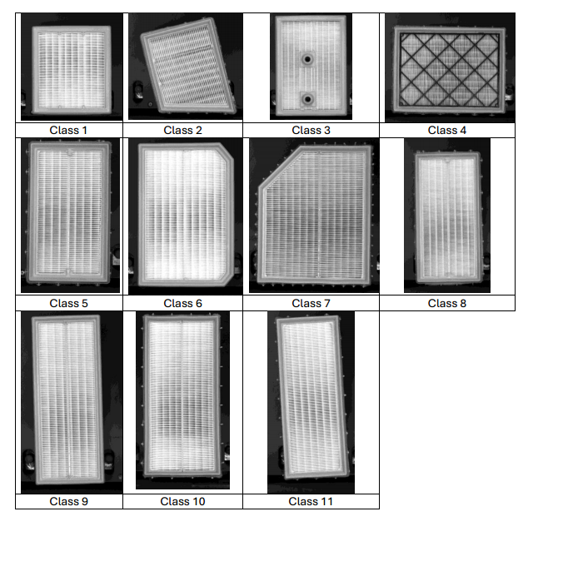
Dataset
11 classes
500 images from each class
Aggressive augmentation
Multiple training datasets
Three test datasets
Type 9 and 11 same except for glue stripe
Too much brightness and contrast increase hurt model

Slide 3
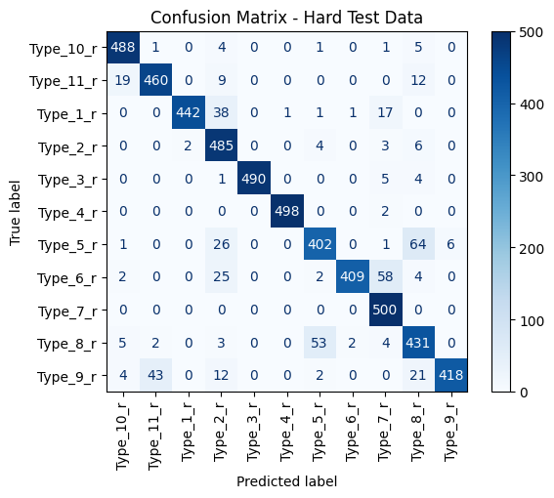
Training
TensorFlow with Keras API
Changing Hyperparamenters:
Model – MobileNetV2, EffitientNetB0
Learning rate – 1E-5, 1E-4
Trainable layers – False, 5, 10, 15
Regularization – Dropout 0.2; Dropout 0.4 + L2
16 CNNs Trained
Testing accuracy on three datasets
Plotting of Confusion Matrix

Slide 4
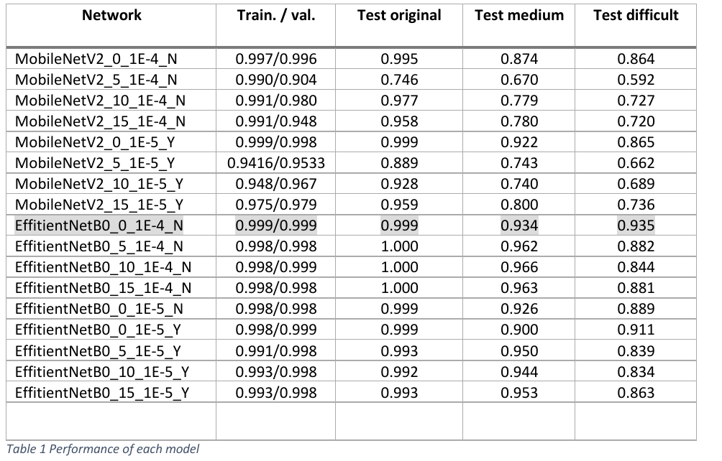
Evaluation
17 models
Test original accuracy was generally high
Test medium and test difficult went „against“ each other in accuracy
1E-4 learning was proved optimal for the dataset
Fine-tunning wasn’t much useful in my case

Slide 5

Conclusion
Models always performed best at normal dataset
The desired goal was achieved through systematic approach
Noise and rotations commonly appear in the real-world example
Avoid overexposed pictures (they eliminate important features)
You should be good to go in real world testing

Slide 6

Thank you for attention

